Slide 1

Oscillator Circuit and Hartly's Oscillator

Slide 2
Group Members
Name : Id :
Abdullah Al Noman 232-15-797
Mohammad Nafis Sadiq 232-15-895
Mahajub Al Shabah 232-15-900
Sachin Sarker 232-15-249
J. M. Ifthakharul Islam Shajan 232-15-813
Md. Al Sahariar Noyn 232-15-814
Pritom Saha Turjo 232-15-742

Slide 3
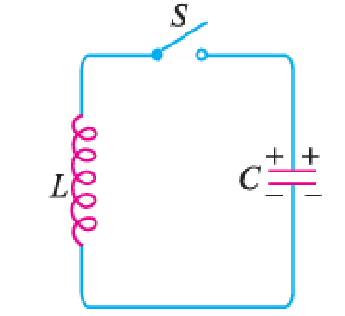
What is an Oscillatory Circuit?
A circuit which produces electrical oscillations of any desired frequency is known as an oscillatory circuit or tank circuit.
A simple oscillatory circuit consists of a capacitor (C) and inductance coil (L) in parallel as shown in Fig.

Slide 4
For Better Understanding
The upper plate has a positive charge, and the lower plate has a negative charge, creating a voltage across the capacitor and storing electrostatic energy.

Slide 5
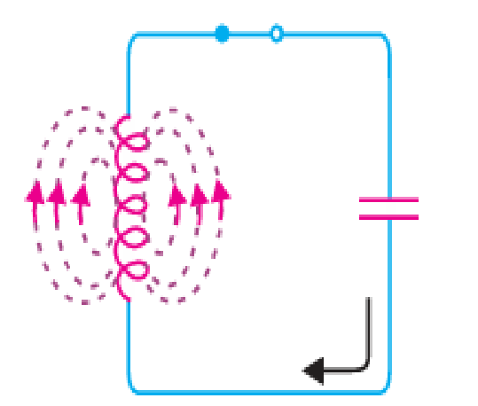
For Better Understanding
When the switch is closed, the capacitor releases its energy through the coil, creating a current and a magnetic field around the coil. The current is strongest when the capacitor is empty, and all the capacitor’s energy has turned into magnetic energy in the coil.

Slide 6
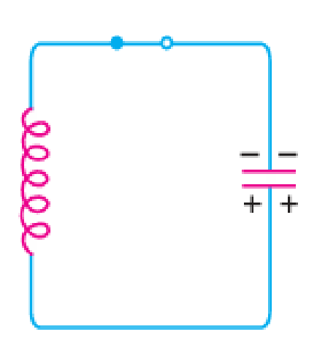
For Better Understanding
Once the capacitor is discharged, the collapsing magnetic field creates a counter e.m.f., keeping the current flowing in the same direction. This recharges the capacitor with opposite polarity, making the upper plate negative and the lower plate positive.

Slide 7
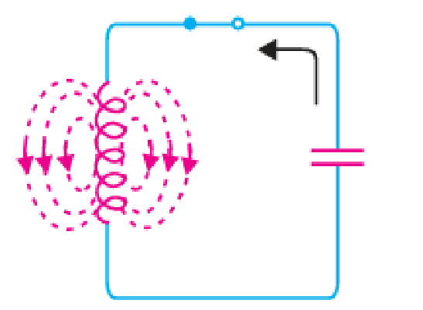
For Better Understanding
After the magnetic field recharges the capacitor, it begins to discharge in the opposite direction. When fully discharged, the current is at its maximum.
The charge and discharge make electrons move back and forth and create an oscillating current. Energy is stored in the capacitor's electric field and the inductor's magnetic field, causing continuous oscillations.

Slide 8

Frequency of Oscillations
The frequency of oscillations in the tank circuit is determined by the constants of the circuit viz L and C. The actual frequency of oscillations is the resonant frequency (or natural frequency) of the tank circuit given by :​

Slide 9
Undamped Oscillations from Tank Circuit
For undamped oscillations in a tank circuit, the following conditions must be met:
The energy supplied should cover losses and the energy removed by the load.
The applied energy must match the frequency of the circuit's oscillations.
The applied energy must be in phase with the oscillations to support them, allowing a transistor amplifier with positive feedback to work as an oscillator.

Slide 10
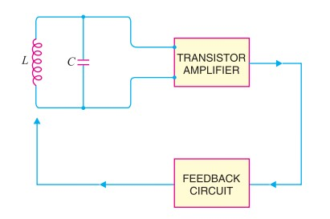
Essentials of Oscillator circuit
Tank Circuit
Coil
Capacitor
Transistor Amplifier
The transistor amplifier converts direct current from the battery into alternating current. It boosts the oscillations from the tank circuit and make them stronger.
Feedback Circuit
The feedback circuit sends part of the amplified signal back to the tank circuit to maintain the oscillations.

Slide 11
Different Types of Transistor Oscillator
What is a Transistor Oscillator?
A transistor oscillator is an electronic circuit that generates a periodic, oscillating signal (e.g., sine wave, square wave) using positive feedback.
Used in applications like signal generation, communication systems, and frequency synthesis.
Basic Components -
Amplifying Transistor: Provides the required gain.
Feedback Network: Ensures positive feedback to maintain oscillation.
Frequency-determining Components: Typically capacitors, inductors, or resistors that set the oscillation frequency.

Slide 12
Types of Transistor Oscillators
Colpitts Oscillator
Hartley Oscillator
Tuned Collector Oscillator
is an LC-based oscillator where the tuning circuit (an LC tank) is connected to the collector of the transistor, making it suitable for RF signal generation.
is an LC-based oscillator commonly used for generating high-frequency signals, especially in RF (radio frequency) applications.
is an LC-based oscillator that generates sinusoidal signals, commonly used in RF (radio frequency) applications.
Wien Bridge Oscillator
Crystal Oscillator
Phase Shift Oscillator
is an RC-based oscillator that generates a stable, low-distortion sine wave, often used in audio and signal generators.
is a highly stable oscillator circuit that uses a quartz crystal for frequency control, ideal for precise timing applications.
is an RC-based oscillator that generates a continuous sine wave at low frequencies, often used in audio applications.

Slide 13
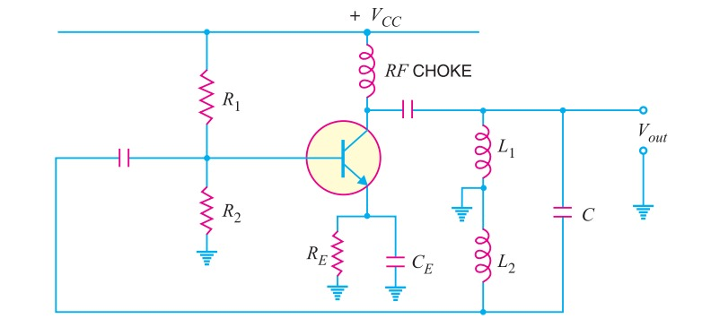
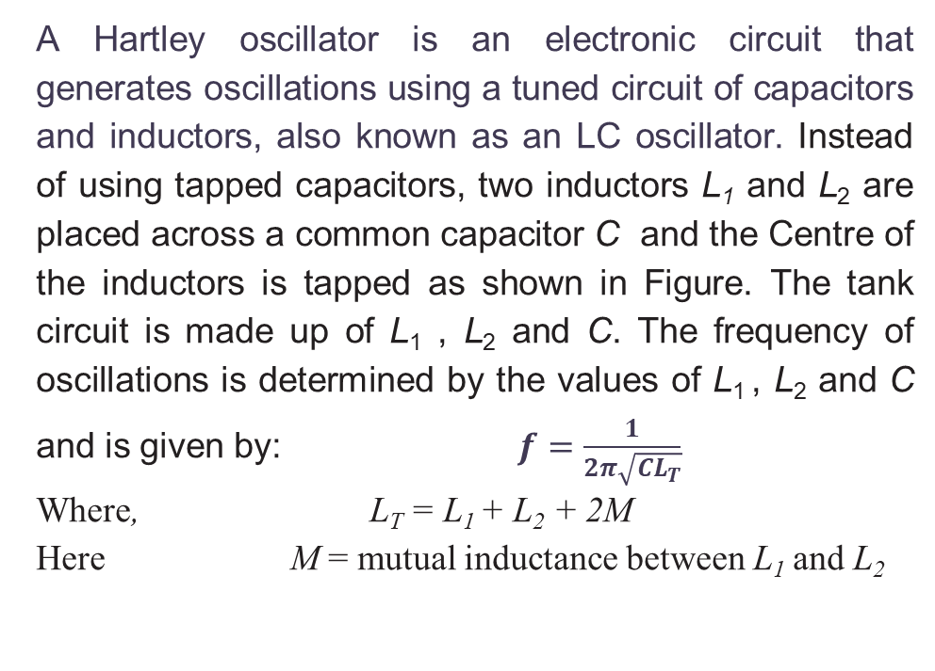
Hartley Oscillator
A Hartley oscillator is an electronic circuit that generates oscillations using a tuned circuit of capacitors and inductors, also known as an LC oscillator. Instead of using tapped capacitors, two inductors L₁ and L₂ are placed across a common capacitor C and the Centre of the inductors is tapped as shown in Figure. The tank circuit is made up of L₁ , L₂ and C. The frequency of oscillations is determined by the values of L₁ , L₂ and C and is given by: $f=\frac{1}{2π\sqrt{CL_{T}}}$
Where, L_{T} = L₁ + L₂ + 2M
Here M = mutual inductance between L₁ and L₂

Slide 14
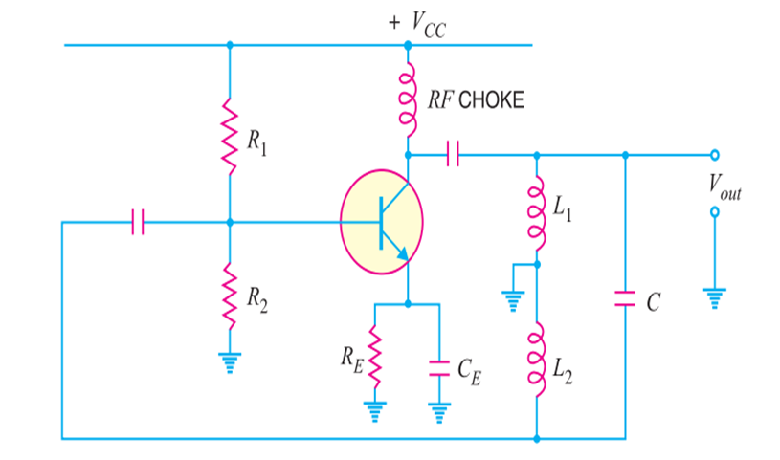
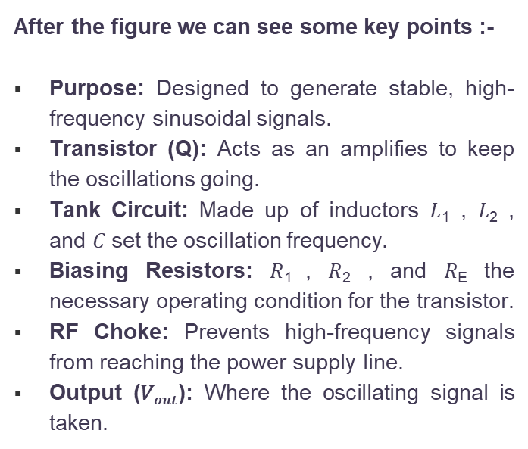
Hartley Oscillator Figure Explanation
After the figure we can see some key points :-
Purpose: Designed to generate stable, high-frequency sinusoidal signals.
Transistor (Q): Acts as an amplifies to keep the oscillations going.
Tank Circuit: Made up of inductors 𝐿₁ , 𝐿_{2​} , and 𝐶 set the oscillation frequency.
Biasing Resistors: 𝑅_{1​} , 𝑅₂ , and 𝑅_{E} the necessary operating condition for the transistor.
RF Choke: Prevents high-frequency signals from reaching the power supply line.
Output (𝑉$out$​): Where the oscillating signal is taken.

Slide 15
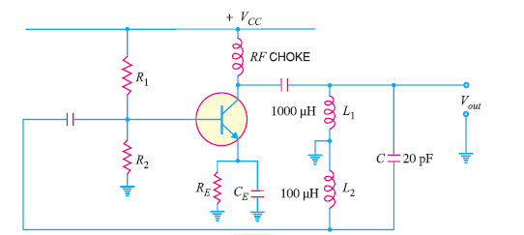
Mathematical Problem
Calculate the (i) operating frequency and (ii) feedback fraction for Hartley oscillator shown in Figure 1. The mutual inductance between the coils, M = 20 μH.
Figure 1

Slide 16
Thank You

